Slide 1
Business Location and Setup
Location
Setup
Vancouver Public Library, Georgia St. Vancouver BC
False Creek Flatz Great Northern Way BC
Expo Line Sky Train Granville Station Vancouver BC
The machines will have all the necessary permits and licenses, adequate space, consistent power and lighting, connection for payment system and will be restocked and maintained on a regular basis.

Slide 2
Inventory Management
Initial Stock
Restocking
Purchase initial inventory worth $3,000, focusing on popular and high-demand items.
A monitoring software will be installed to automatically notify the proprietor when the machines needed restocking.

Slide 3
Equipment Maintenance
Routine Checks
Repairs
A regular monthly maintenance checks will be conducted to ensure machines are functioning correctly.
A protocol will be in place for quick repairs in case of malfunctions to minimize downtime.

Slide 4
General Operation
Staffing
General Customer Service
The proprietor will be the only staff in the first year. A salary staff will be added on the succeeding year depending on the potential expansion.
Customers will have the opportunity to voice out complaints, suggestions and recommendations via email. This email will be monitored regularly.
Cash Accountability
Cash will be collected from the machines and accounted on a bi-weekly basis.

Slide 5
Implementation Plan
Implementation Plan
Phase 1: Pre-Launch (Month 1)
•Secure Locations: Finalize agreements with property owners for machine placements.
•Purchase Equipment: Acquire vending machines and initial inventory.
Phase 2: Launch (Month 2)
•Install Machines: Set up vending machines at designated locations.
•Initial Stocking: Stock machines with initial inventory.
Phase 3: Growth and Expansion (Months 3-12)
•Monitor Sales: Track sales data to identify high-performing locations and products.
•Adjust Inventory: Optimize inventory based on sales trends.
•Expand Locations: Identify additional high-traffic areas for new machine placements.
Phase 4: Year 2 and Year 3
•Increase Inventory: Scale up inventory purchases to meet growing demand.
•Enhance Marketing: Increase marketing budget to expand reach.
•Evaluate Performance: Conduct annual reviews to assess business performance and make necessary adjustments.

Slide 6
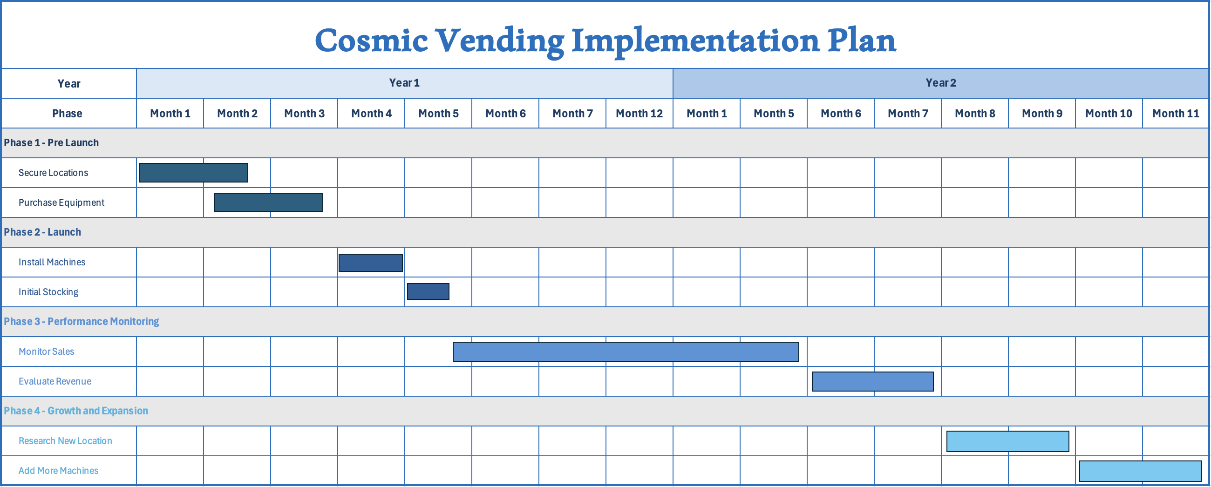
Implementation Plan Timeline

